Slide 1
Lab Exercise: 3
Constraint satisfaction Problem
Crypt-arithmetic Problems
Base + Ball = Games

Slide 2
Constraint Satisfaction Problems
A constraint satisfaction problem (CSP) is a problem that requires its solution within some limitations or conditions also known as constraints. It consists of the following:
A finite set of variables which stores the solution (V = {V1, V2, V3,....., Vn})
A set of discrete values known as domain from which the solution is picked (D = {D1, D2, D3,.....,Dn})
A finite set of constraints (C = {C1, C2, C3,......, Cn})

Slide 3
Solution
Each state in a CSP is defined by an assignment of values to some or all of the variables
An assignment that does not violate any constraints is called a consistent or legal assignment
A complete assignment is one in which every variable is assigned
A solution to a CSP is consistent and complete assignment
Allows useful general-purpose algorithms with more power than standard search algorithms

Slide 4

Crypt-arithmetic Problems :Problem Statement
Solve the following puzzle by assigning numeral (0-9) in such a way that each letter is assigned unique digit which satisfy the following addition
Constraints : No two letters have the same value. (The constraints of arithmetic)

Slide 5
Crypt-arithmetic Problems : Base + Ball = Games
Algorithm
For this problem, we will define a node, which contains a letter and its corresponding values.
isValid(nodeList, count, word1, word2, word3)
Input − A list of nodes, the number of elements in the node list and three words.
Output − True if the sum of the value for word1 and word2 is same as word3 value.
permutation(nodeList, count, n, word1, word2, word3)
Input − List of nodes, number of items in the list, number of assigned letters and three words.
Output − True when all letters are assigned with values correctly to solve the sum.

Slide 6
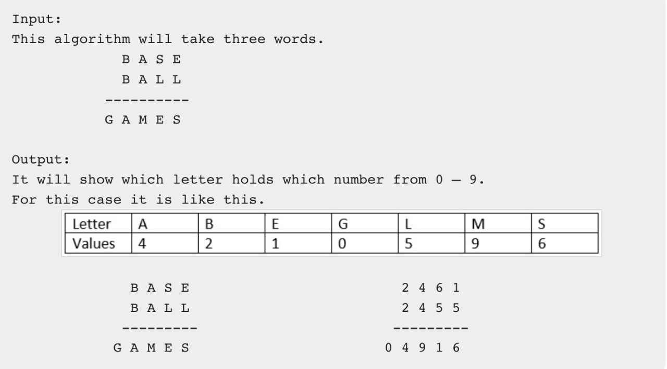
Crypt-arithmetic Problems : Base + Ball = Games

Slide 7
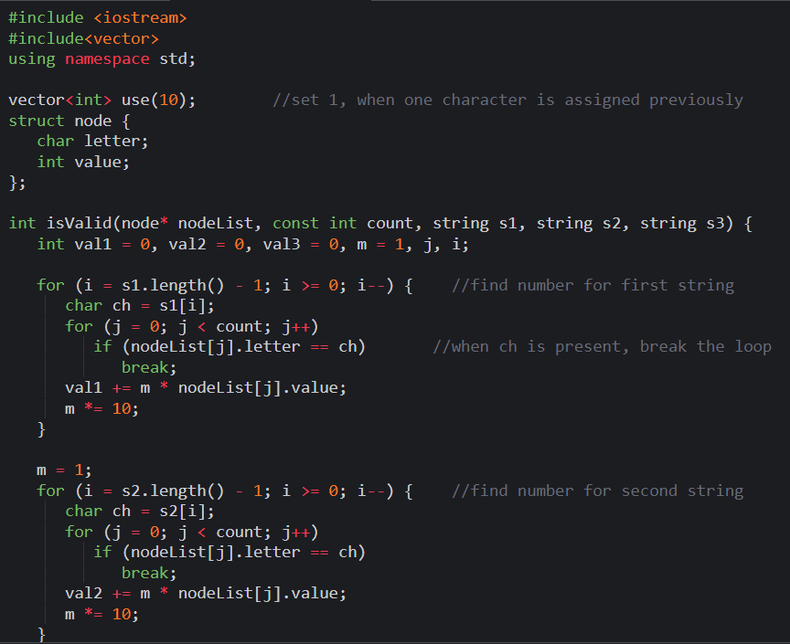
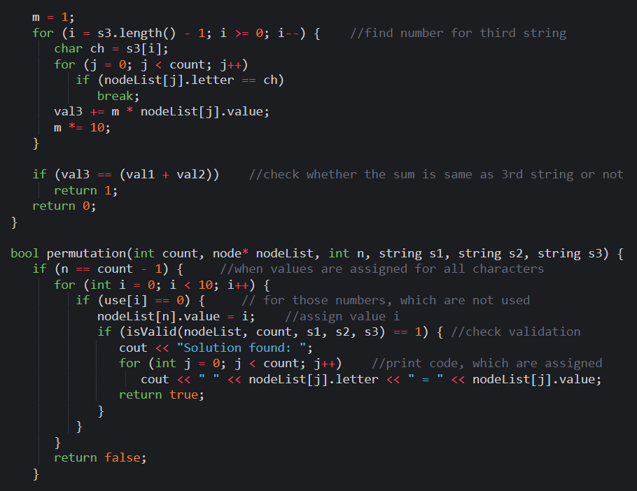
Crypt-arithmetic Problem: Base + Ball = Games

Slide 8
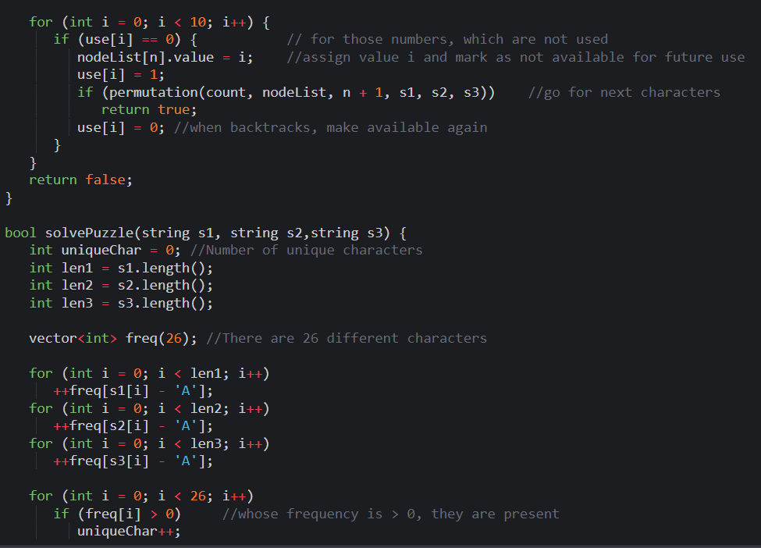
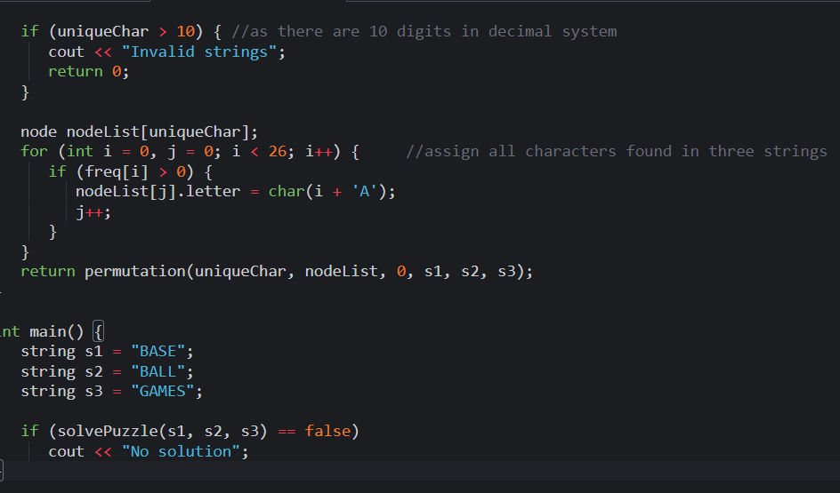
Crypt-arithmetic Problem: Base + Ball = Games

Slide 9
Crypt-arithmetic Problem: Base + Ball = Games
Output:

Slide 10
Thank You
VIVEK BURUGUDDA RA1911003010316
HARSHIL AGARWAL RA1911003010325
RITESH RAI RA1911003010333
PUNEET SHARMA RA1911003010331
PRAKHAR VIJAY RA1911003010337

